Slide 1
CSDS 451: Designing High Performant Systems for AI
Lecture 3
9/2/2025
Sanmukh Kuppannagari
sanmukh.kuppannagari@case.edu
https://sanmukh.research.st/
Case Western Reserve University

Slide 2
Outline
Processor Memory Architectures
Memory Optimizations to Improve Performance
Processor Memory Architectures with Cache
Blocked Matrix Multiplication

Slide 3
Announcements
PA 0 due this Thursday
WA 1 will be out Thursday
Will cover topics till lecture 6
TA Information and Office hours will be posted by tonight

Slide 4
Outline
Processor Memory Architectures
Memory Optimizations to Improve Performance
Processor Memory Architectures with Cache
Blocked Matrix Multiplication
Modeling GPU Architectures

Slide 5
Recall: Memory System
System performance (execution time) depends on the “rate” at which data can be accessed by the program
M (DRAM)
Updated Execution Model
Latency: Time to receive the first word since the fetch instruction
Bandwidth: Rate of data transfer = bitwidth of the interconnect x frequency
64
P
Execute – 1 cycle
Fetch – Latency + Data size/bandwidth cycles
With DRAM access latency of 100s of cycles,
Need latency hiding mechanisms

Slide 6
Recall: System Performance Metrics
Actual System Performance
Latency Hiding Mechanisms
Efficient Bandwidth Utilization
0.048 Gflops/s
0.4 Gflops/s
2 Gflops/s
Sustained Worst Case
Latency dominant
Sustained Best Case
Latency Hidden
Memory bandwidth dominant
Peak Performance
Compute Only

Slide 7
System Performance Metrics
If actual performance less than Sustained Performance (best case)
Latency not fully hidden – employ optimizations to hide latency
Memory bandwidth not fully utilized – employ optimizations to improve bandwidth
If actual performance more than Sustained Performance (best case) but less than Peak Performance
Latency is hidden, memory bandwidth is fully utilized
Need to perform more computations on the fetched data (may or may not be possible depending upon the algorithm)

Slide 8
Techniques to Improve Application Performance
Compute Parallelization
Decompose tasks to enable concurrent processing (we will discuss later in this course)
Memory Optimizations
Optimizations addressing latency
Optimizations targeted toward maximizing bandwidth utilization
Optimizations that maximize computations on the fetched data (in other words, reduce the amount of data transfers that need to occur)

Slide 9
Learning Objectives
Understand the optimizations addressing latency
Understand the optimizations targeted toward maximizing bandwidth utilization
Understand optimizations that reduce the amount of data transfer and maximize computations

Slide 10
#1 Optimizations Targeting Latency
Key ideas
Latency of a single data item cannot be reduced due to physical constraints
Try to hide the latency by doing some independent useful work such as
Data transfer
computations
Read
-19
0
0.5
1
ns
Latency
Read Request
Time of data arrival

Slide 11
#1 Optimizations Targeting Latency
Latency Hiding using data transfers
Avoid per data latency (Sustained Performance (worst case)) by multiple requests in sequence
After an initial latency, data arrives continuously
Read
Read
Read
0
0.5
1
1.5
2
2.5
3
ns
-19
Latency
Read Request
Times of data arrival

Slide 12
#1 Optimizations Targeting Latency
Latency hiding using data transfers
In practice, consecutive requests to random locations leads to addition memory device specific latencies
Accessing sequential data leads to higher performance
Read
Read
Read
0
0.5
1
1.5
2
2.5
3
ns
-19
Latency
Read Request
Times of data arrival

Slide 13
#1 Optimizations Targeting Latency
Latency hiding using data transfers
Key takeaway for this course: data transfers of sequential datastructures (such as arrays) leads to streaming data transfers, i.e., data transfers where latencies for the subsequent data items is hidden.
Read
Read
Read
0
0.5
1
1.5
2
2.5
3
ns
-19
Latency
Recall last class: Fetch request format: read 100 elements starting at location 0.
Read Request
Times of data arrival

Slide 14
#1 Optimizations Targeting Latency
Latency hiding using computation
Several mechanisms exist
Prefetching
Thread switching
…
Mostly provided by the hardware/operating system
Prefetching is provided as an option to algorithm developer – we will revisit later in the class

Slide 15
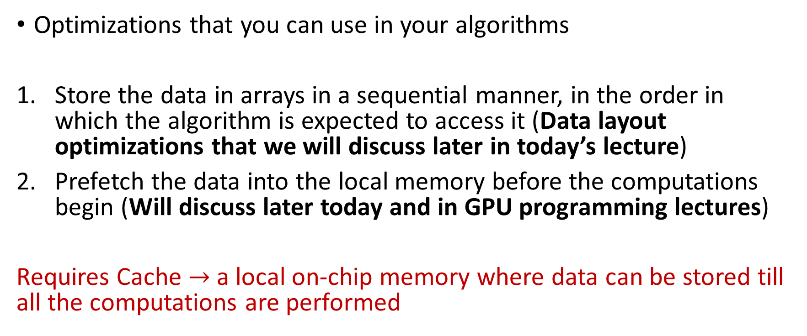
#1 Optimizations Targeting Latency
Optimizations that you can use in your algorithms
Store the data in arrays in a sequential manner, in the order in which the algorithm is expected to access it (Data layout optimizations that we will discuss later in today’s lecture)
Prefetch the data into the local memory before the computations begin (Will discuss later today and in GPU programming lectures)
Requires Cache $→$ a local on-chip memory where data can be stored till all the computations are performed

Slide 16
#2 Optimizations to Improve Bandwidth
Key Idea
Memory systems have wide “buses” – bunch of wires that transfer data from memory to processors
Bandwidth is essentially buswidth X clock frequency
Pack the bus as much as possible in each cycle to transfer more data
M (DRAM)
M (DRAM)
64
Should pack 64 bits in each cycle to maximize bandwidth
P
P

Slide 17
#2 Optimizations to Improve Bandwidth
In Practice
Accessing sequential data leads to better packing
Memories usually have much larger bitwidth than 64 bits
Nvidia A100’s memory has 5120 bit (615 bytes) wide bus.
M (DRAM)
M (DRAM)
64
Should pack 64 bits in each cycle to maximize bandwidth
P
P

Slide 18
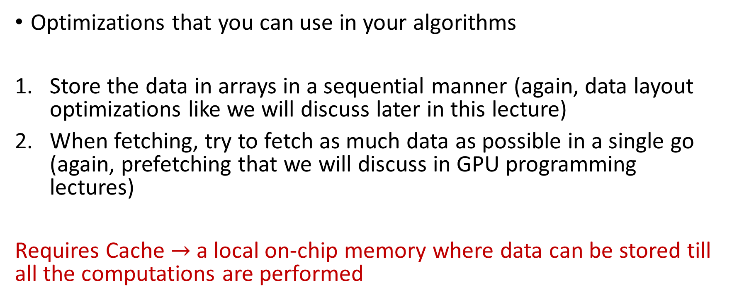
#2 Optimizations to Improve Bandwidth
Optimizations that you can use in your algorithms
Store the data in arrays in a sequential manner (again, data layout optimizations like we will discuss later in this lecture)
When fetching, try to fetch as much data as possible in a single go (again, prefetching that we will discuss in GPU programming lectures)
Requires Cache $→$ a local on-chip memory where data can be stored till all the computations are performed

Slide 19
Memory Optimizations #1 and #2
Similar strategies
Should help us achieve Sustained Performance (best case)
Theoretically. In practice, getting 0 latency or 100% bandwidth utilization is very difficult, so performance may still be lower.
Now the next step to improve performance further will be to maximize the computations performed on the fetched data
We will call this – optimizations to maximize data reuse (we reuse fetched data for computations as much as possible)
Maximizing data reuse implies reducing data transfers

Slide 20
#3 Optimizations to Maximize Data Reuse
Objective is to maximize the computations that can be performed on the data once fetched
Most of the memory optimizations employed in application acceleration research fall under this category

Slide 21
#3 Optimizations to Maximize Data Reuse
Algorithms typically perform multiple operations on various data items
N
0
0
0,0
0,1
0,2
M
=
M
X
N
1
1
1,0
1,1
1,1
2
C
A
B

Slide 22
#3 Optimizations to Maximize Data Reuse
Data Reuse: How many times (on average) an input/output location is used
N
0
0
0,0
0,1
0,2
M
=
M
X
N
1
1
1,0
1,1
1,1
2
C
A
B

Slide 23
#3 Optimizations to Maximize Data Reuse
N
0
Data Reuse for B???
0
0,0
0,1
0,2
M
=
M
X
N
1
1
1,0
1,1
1,1
2
C
A
B

Slide 24
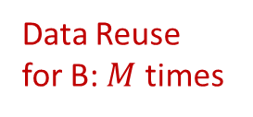
#3 Optimizations to Maximize Data Reuse
N
0
Data Reuse for B: $M$ times
0
0,0
0,1
0,2
M
=
M
X
N
1
1
1,0
1,1
1,1
2
C
A
B

Slide 25
#3 Optimizations to Maximize Data Reuse
Data Reuse for A???
N
0
0
0,0
0,1
0,2
M
=
M
X
N
1
1
1,0
1,1
1,1
2
C
A
B

Slide 26
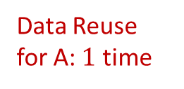
#3 Optimizations to Maximize Data Reuse
Data Reuse for A: $1$ time
N
0
0
0,0
0,1
0,2
M
=
M
X
N
1
1
1,0
1,1
1,1
2
C
A
B

Slide 27
#3 Optimizations to Maximize Data Reuse
Data Reuse for A+B+C???
N
0
0
0,0
0,1
0,2
M
=
M
X
N
1
1
1,0
1,1
1,1
2
C
A
B

Slide 28
#3 Optimizations to Maximize Data Reuse
Data Reuse for A+B+C : $\frac{MN×1+N×M+M×N}{MN+M+N}=\frac{3MN}{MN+M+N} \sim O\left(1\right); M,N≪MN$
N
0
0
0,0
0,1
0,2
M
=
M
X
N
1
1
1,0
1,1
1,1
2
C
A
B

Slide 29

#3 Optimizations to Maximize Data Reuse
How do we make sure that each data item of B is fetched just once and used $M$ times?

Slide 30
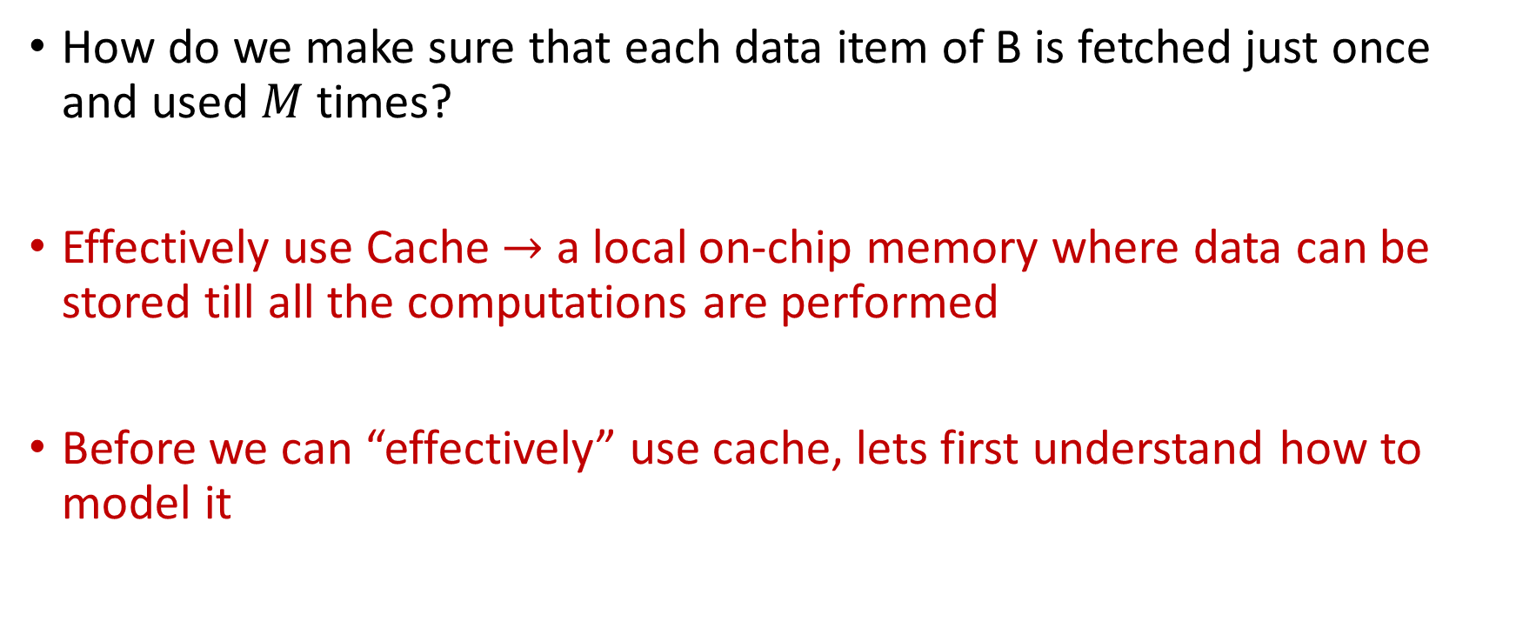
#3 Optimizations to Maximize Data Reuse
How do we make sure that each data item of B is fetched just once and used $M$ times?
Effectively use Cache $→$ a local on-chip memory where data can be stored till all the computations are performed
Before we can “effectively” use cache, lets first understand how to model it

Slide 31
Execution Model with Cache
DRAM
4 GB
Latency: 10 ns
64
C
Cache
Small (16 MB)
Fast (2 GHz)
Processor
Bandwidth = 64 bits at 1 GHz
(64 Gbits/sec or 8 GB/sec) or
(64 bits in every 2 processor cycles) or 1 word in 1 ns
Fetch_Memory – Latency + Data size/bandwidth
Fetch_Cache – 1 cycle
Execute – 1 cycle
Read/Write from DRAM to/from Cache
Basic Execution Model

Slide 32
Execution Model with Cache
Assumptions
Fetch_Memory: DRAM <-> Cache
Processor has a limited number of registers, say 3-4
You can decide what “limited” means
Enough such that you don’t need complicated code
But not so large that you do not require cache anymore

Slide 33
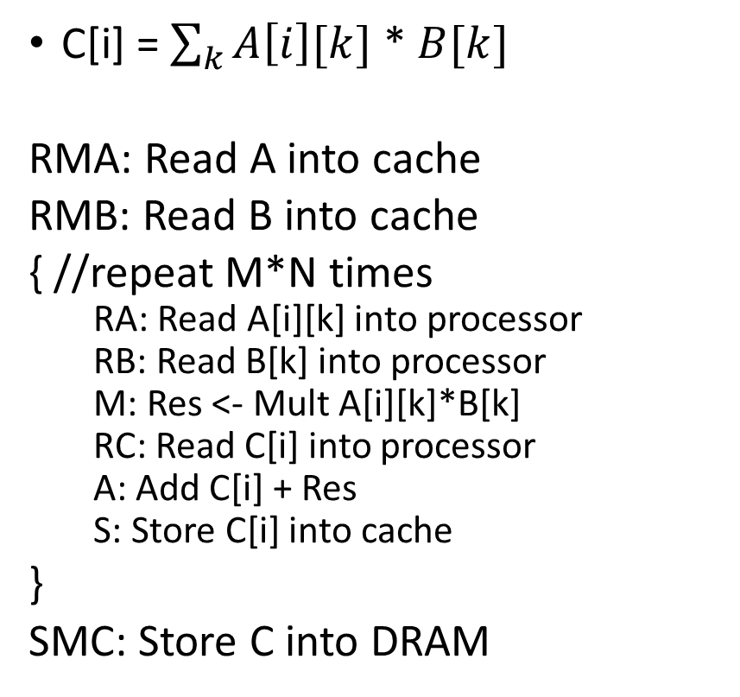
Execution Model with Cache Calculating Algorithm Performance
C[i] = $\sum_{k}{A\left[i\right][k]}$ * $B[k]$
RMA: Read A into cache
RMB: Read B into cache
{ //repeat M*N times
RA: Read A[i][k] into processor
RB: Read B[k] into processor
M: Res <- Mult A[i][k]*B[k]
RC: Read C[i] into processor
A: Add C[i] + Res
S: Store C[i] into cache
}
SMC: Store C into DRAM

Slide 34
Execution Model with Cache Calculating Algorithm Performance
C[i] = $\sum_{k}{A\left[i\right][k]}$ * $B[k]$
RMA: Read A into cache
RMB: Read B into cache
{ //repeat M*N times
RA: Read A[i][k] into processor
RB: Read B[k] into processor
M: Res <- Mult A[i][k]*B[k]
RC: Read C[i] into processor
A: Add C[i] + Res
S: Store C[i] into cache
}
SMC: Store C into DRAM
This is prefetching which avoids the latency of fetching each M*N RA, RB, and S operations

Slide 35
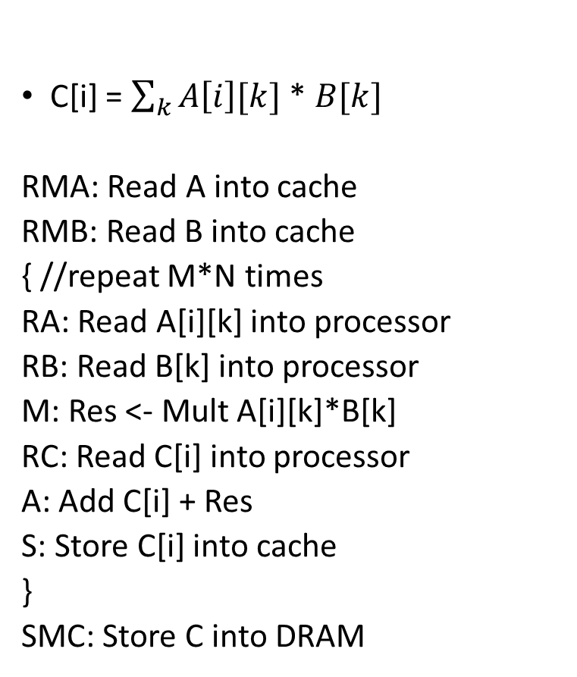
Execution Model with Cache Calculating Algorithm Performance
C[i] = $\sum_{k}{A\left[i\right][k]}$ * $B[k]$
RMA: Read A into cache
RMB: Read B into cache
{ //repeat M*N times
RA: Read A[i][k] into processor
RB: Read B[k] into processor
M: Res <- Mult A[i][k]*B[k]
RC: Read C[i] into processor
A: Add C[i] + Res
S: Store C[i] into cache
}
SMC: Store C into DRAM
??
??
??
??

Slide 36
Execution Model with Cache Calculating Algorithm Performance
C[i] = $\sum_{k}{A\left[i\right][k]}$ * $B[k]$
RMA: Read A into cache
RMB: Read B into cache
{ //repeat M*N times
RA: Read A[i][k] into processor
RB: Read B[k] into processor
M: Res <- Mult A[i][k]*B[k]
RC: Read C[i] into processor
A: Add C[i] + Res
S: Store C[i] into cache
}
SMC: Store C into DRAM
10 + MN ns
10 + N ns
3MN ns
10 + N ns

Slide 37
Execution Model with Cache
System Performance: ??

Slide 38
Execution Model with Cache
System Performance:
2MN useful operations
Time (ns): 30 + 3MN + MN + 2N
System Performance (GFLOPs): 2MN/(30 + 4MN + 2N)

Slide 39
Execution Model with Cache
Recall
Peak Performance: 2 GFLOPs
Sustained Performance (best case): 0.4 GFLOPs
Sustained Performance (worst case): 0.048 GFLOPs
Sustained Performance (with cache): 2MN/(30 + 4MN + 2N)

Slide 40
Execution Model with Cache
Recall
Peak Performance: 2 GFLOPs
Sustained Performance (best case): 0.4 GFLOPs
Sustained Performance (worst case): 0.048 GFLOPs
Sustained Performance (with cache): 2MN/(4MN)
For large MN

Slide 41
Execution Model with Cache
Recall
Peak Performance: 2 GFLOPs
Sustained Performance (best case): 0.4 GFLOPs
Sustained Performance (worst case): 0.048 GFLOPs
Sustained Performance (with cache): 0.5 GFLOPs
For large MN

Slide 42
Execution Model with Cache
Ungraded HW assignment (may include as a question in WA 1, or even better, in the exam)
Why is the performance marginally better than Sustained Performance (best case)? Why not lower or significantly better?

Slide 43
Memory Bound Applications
Why is the performance still significantly lower than peak performance?
Peak Performance: 2 GFLOPs
Sustained Performance (best case): 0.4 GFLOPs
Sustained Performance (with cache): 0.5 GFLOPs

Slide 44
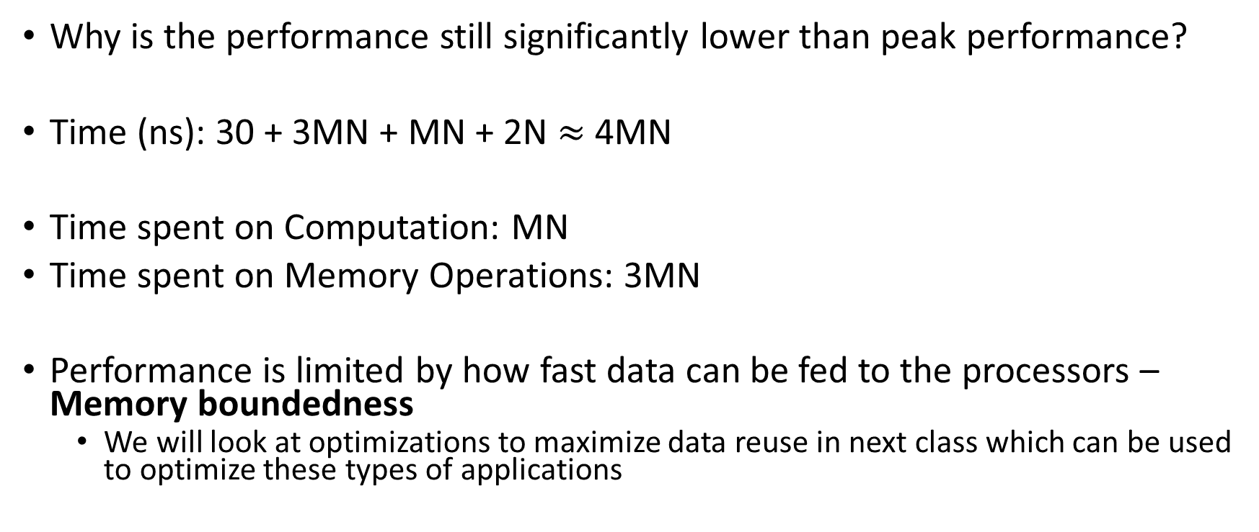
Memory Bound Applications
Why is the performance still significantly lower than peak performance?
Time (ns): 30 + 3MN + MN + 2N $≈$ 4MN
Time spent on Computation: MN
Time spent on Memory Operations: 3MN
Performance is limited by how fast data can be fed to the processors – Memory boundedness
We will look at optimizations to maximize data reuse in next class which can be used to optimize these types of applications

Slide 45
Cache Limitations
In practice, cache size is limited
Previously fetched data is evicted from cache, if no space.
We need to carefully design our algorithms to obtain best performance using cache
Enable effective utilization of cache to maximize data reuse and minimize data transfers

Slide 46
Optimizations to Enable Effective Utilization of Cache
#1 Data Layout Optimizations
#2 Algorithm Reordering to Maximize Data Reuse

Slide 47
#1 Data Layout Optimization
A in Memory
Cache
Need to Fetch elements 2 at a time to cache.
Each Fetch_Memory – Latency + data size/bandwidth

Slide 48
#1 Data Layout Optimization
A in Memory
Cache
Need to Fetch elements 2 at a time to cache.
Each Fetch_Memory – Latency + data size/bandwidth

Slide 49
#1 Data Layout Optimization
A in Memory
Cache
Need to Fetch elements 2 at a time to cache.
Each Fetch _Memory – Latency + data size/bandwidth

Slide 50
#1 Data Layout Optimization
A in Memory
Cache
Need to Fetch elements 2 at a time to cache.
Each Fetch _Memory – Latency + data size/bandwidth

Slide 51
#1 Data Layout Optimization
A in Memory
Cache
Need to Fetch elements 2 at a time to cache.
Each Fetch _Memory – Latency + data size/bandwidth

Slide 52
#1 Data Layout Optimization
A in Memory
0
1
2
3
4
5
6
7
8
Cache
Algorithm access Pattern: 0, 2, 4, 6, 8, 1, 3, 5, 7

Slide 53
#1 Data Layout Optimization
A in Memory
0
1
2
3
4
5
6
7
8
Cache
Algorithm access Pattern: 0, 2, 4, 6, 8, 1, 3, 5, 7
Number of Fetch_Memory Needed: ??

Slide 54
#1 Data Layout Optimization
A in Memory
0
1
2
3
4
5
6
7
8
Cache
Algorithm access Pattern: 0, 2, 4, 6, 8, 1, 3, 5, 7
Number of Fetch_Memory Needed: 9

Slide 55
#1 Data Layout Optimization
A in Memory
??
??
??
??
??
??
??
??
??
Cache
Algorithm access Pattern: 0, 2, 4, 6, 8, 1, 3, 5, 7
Number of Fetch_Memory Needed: ??

Slide 56
#1 Data Layout Optimization
A in Memory
0
2
4
6
8
1
3
5
7
Cache
Algorithm access Pattern: 0, 2, 4, 6, 8, 1, 3, 5, 7
Number of Fetch_Memory Needed: 5

Slide 57
#1 Data Layout Optimization
A in Memory
0
1
2
3
4
5
6
7
8
Cache
Or Change Algorithm access Pattern: 0, 1,2,3,4,5,6,7,8
Number of Fetch_Memory Needed: 5

Slide 58
#1 Data Layout Optimization
Objective: Ensure sequential access to data stored in memory by,
Either, storing data in the right format
Or, reordering computations (access pattern of program)

Slide 59

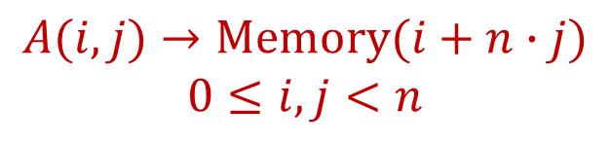




#1 Data Layout Optimization
Storing a 2-dimemsional array in memory
Row major order
Column major order
Memory
Memory
0
$n$-1
0
$n$-1
0
0
Map
Map
…
…
$n$-1
$n$-1
$$A(i,j)→Memory(i∙n+j)$$
$$0≤i, j<n$$
$$A(i,j)→Memory(i+n∙j)$$
$$0≤i,j<n$$

Slide 60



#1 Data Layout Optimization
For k = 1 to n
For i = 1 to n
C[i] <- A[i][k] + B[k] + C[i]
Assume $A$ is stored in row major order
0
$n$-1
0
…
$n$-1
Column major access pattern
Row major order
Data Access not sequential
Each read of A[i][k] will incur latency
Data Layout
Access pattern of the program

Slide 61

#1 Data Layout Optimization
Assume $A$ is stored in row major order
For i = 1 to m
For k = 1 to n
C[i] <- A[i][k] + B[k] + C[i]
Row major access pattern
Data Access sequential
Read A[i][k] at the rate of bandwidth
Data Layout
Access pattern of the program

Slide 62
#1 Data Layout Optimization
Alternate Solution: Store A in Column major order
Data Access sequential
Read A[i][k] at the rate of bandwidth
Access pattern of the program
Data Layout

Slide 63
#1 Data Layout Optimization: Summary
We should align the layout of the data in the memory to match with the access pattern of the algorithm
Simple N-D row/column major layout should be sufficient for most purposes
Access patterns may change over iterations of the algorithm
For example, 2D FFT
Algorithm designers sometimes employ dynamic data layout changing mechanisms, if the overheads are justified
We will not discuss dynamic data layout optimizations in this class

Slide 64
#2 Improving Data Reuse
Our objective is to reduce the number of data transfers of input and output
If a data element is used multiple times, try to reorder the algorithm such that all its uses are “temporally” close to each other
We will discuss this in the next class when we look at how to reorder matrix multiplication algorithm to improve data reuse

Slide 65
Next Class
9/4 Lecture 4 – Blocked MM for improving data reuse, Modeling GPU Architectures

Slide 66
Thank You
Questions?
Email: sanmukh.kuppannagari@case.edu

